Slide 1
Data Communication & Networking CE253
Prepared by:
Michele Mistry,
Assistant Professor,
Department of Computer Engineering,
DEPSTAR, CHARUSAT

Slide 2
Data Terminal Equipment (DTE )
It is the equipment which terminates flow of information in any communication network. • Located inside or near customer premises. • Purchased or owned by customers utilizing service. • EXAMPLES: Computers, laptops, routers, bridges etc.

Slide 3
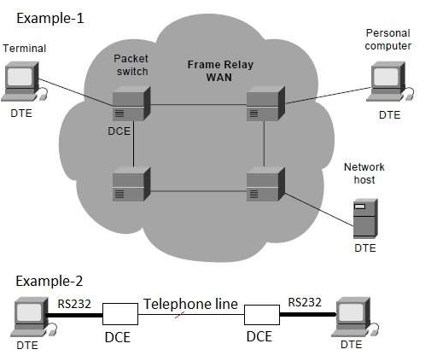
Data Terminal Equipment (DTE )

Slide 4
Data Circuit Terminating Equipment (DCE)
It is the equipment which transport information over communication medium.
Located in between DTE and communication medium (i.e. fiber cable, twisted pair).
It takes care providing functions such as coding, clocking etc. for the information to be transmitted and received.
Also known as "Data Carrier Equipment"
EXAMPLES: Modem, Switch etc.

Slide 5
Data Circuit Terminating Equipment (DCE)
The protocol stack between DTE and DCE consists of two layers viz. PHYSICAL LAYER and Data Link Layer (or MAC layer).
Physical Layer specifies electrical, mechanical, functional and procedural specifications.
Data Link layer takes care of error detection and flow control between DTE and DCE.

Slide 6
Modems
Modem is short for "Modulator / Demodulator.“
It is a hardware component that allows a computer or other device, such as a router or switch, to connect to the Internet.
Converts or "modulates" an analog signal from a telephone or cable wire to a digital signal that a computer can recognize.
Similarly, it converts outgoing digital data from a computer or other device to an analog signal.

Slide 7
Cable Modems
A cable modem is a device that enables you to hook up your PC to a local cable TV line and receive data at about 1.5 Mbps.
This data rate far exceeds that of the prevalent 28.8 and 56 Kbps telephone modems and the up to 128 Kbps of Integrated Services Digital Network (ISDN) and is about the data rate available to subscribers of Digital Subscriber Line (DSL) telephone service.

Slide 8
Cable Modems
A cable modem can be added to or integrated with a set-top box that provides your TV set with channels for Internet access.
In most cases, cable modems are furnished as part of the cable access service and are not purchased directly and installed by the subscriber.
A cable modem has two connections: one to the cable wall outlet and the other to a PC or to a set-top box for a TV set.
Complex device than a telephone modem.
Can be an external device or it can be integrated within a computer or set-top box.

Slide 9
PSTN
PSTN (public switched telephone network) is the world’s collection of interconnected voice-oriented public telephone networks.
The traditional circuit-switched telephone network.
PTSN comprises all the switched telephone networks around the world that are operated by local, national or international carriers.
These networks provide the infrastructure and the services for public telecommunication.

Slide 10
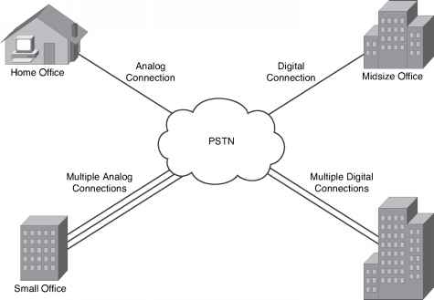
PSTN

Slide 11
PSTN
PSTN structure
The traditional PSTN has a hierarchical architecture and a star structure.
The individual subscriber lines are connected to a local exchange, which communicates with trunk exchanges as well as main and central exchanges.
The lines within a local exchange typically have the same area code.
A user who wants to call a number outside the local exchange has to add an area code.
To make an international call, a user has to dial the country code.

Slide 12
PSTN
A PSTN lets users make landline telephone calls to one another.
A PSTN is made up of switches at centralized points on a network that function as nodes to enable communication between two points on the network. A call is placed after being routed through multiple switches. Voice signals can then travel over the connected phone lines.

